Slide 1
Knowledge Representation & Reasoning
COMP 41400: Multi-Agent Systems
Lecturer: Rem Collier
Email: rem.collier@ucd.ie

Slide 2
Types of Knowledge
Declarative Knowledge: How to represent what we know?
e.g. facts, concepts, objects, databases, …
Procedural Knowledge: How to do stuff?
e.g. rules, strategies, procedures, …
Meta-Knowledge: Knowledge about Knowledge
e.g. planning, modelling, tagging, …
Heuristic Knowledge: Applied knowledge that is good but not guaranteed
e.g. rules of thumb, insights, …
Structural Knowledge: How to integrate / interrelate knowledge
e.g. kind of, part of, …

Slide 3

Types of Knowledge
Declarative Knowledge: How to represent what we know?
Procedural Knowledge: How to do stuff?
Meta-Knowledge: Knowledge about Knowledge
Heuristic Knowledge: Applied knowledge that is good but not guaranteed

Slide 4
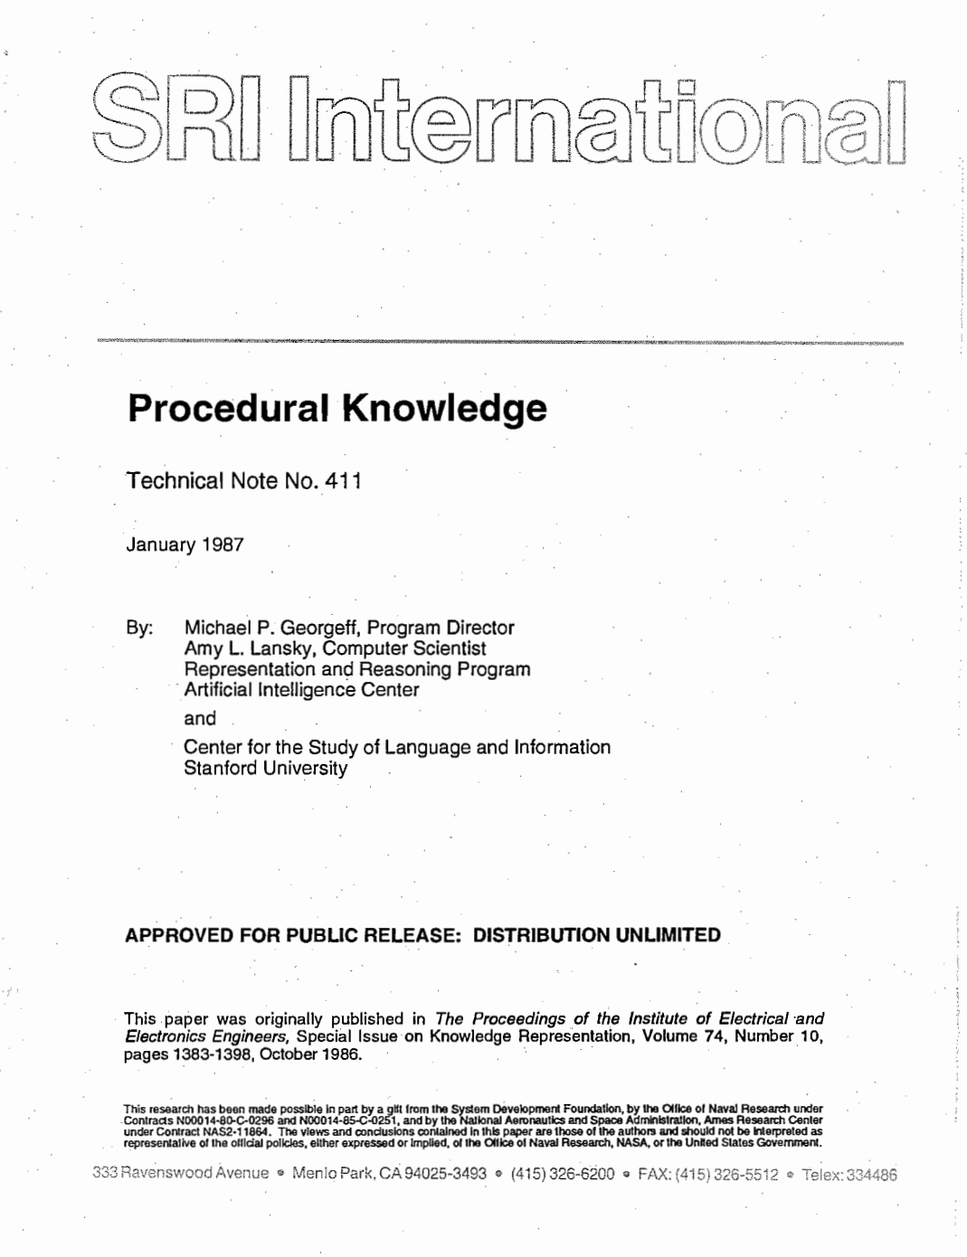
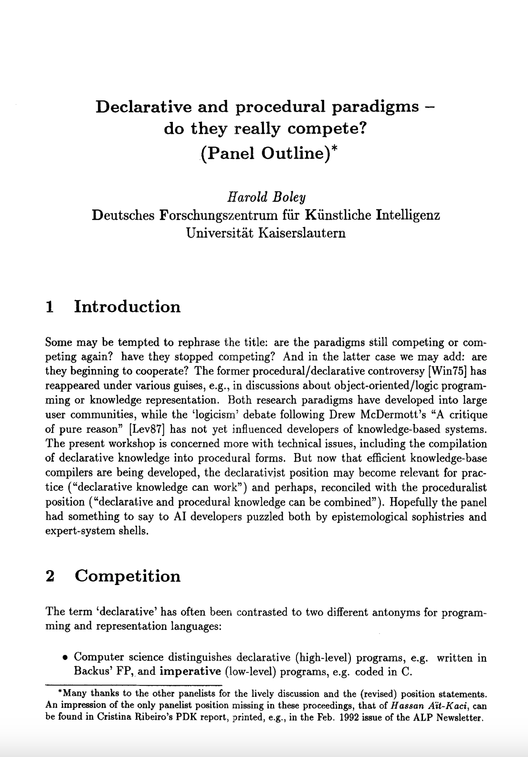
Types of Knowledge
Declarative Knowledge: How to represent what we know?
e.g. facts, concepts, objects, databases, …
Procedural Knowledge: How to do stuff?
e.g. rules, strategies, procedures, …
Meta-Knowledge: Knowledge about Knowledge
e.g. planning, modelling, tagging, …
Heuristic Knowledge: Applied knowledge that is good but not guaranteed
e.g. rules of thumb, insights, …
Structural Knowledge: How to integrate / interrelate knowledge
e.g. kind of, part of, …
https://www.researchgate.net/publication/2997588_Procedural_Knowledge
https://link.springer.com/content/pdf/ 10.1007/BFb0013545.pdf

Slide 5
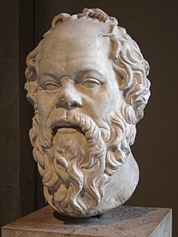
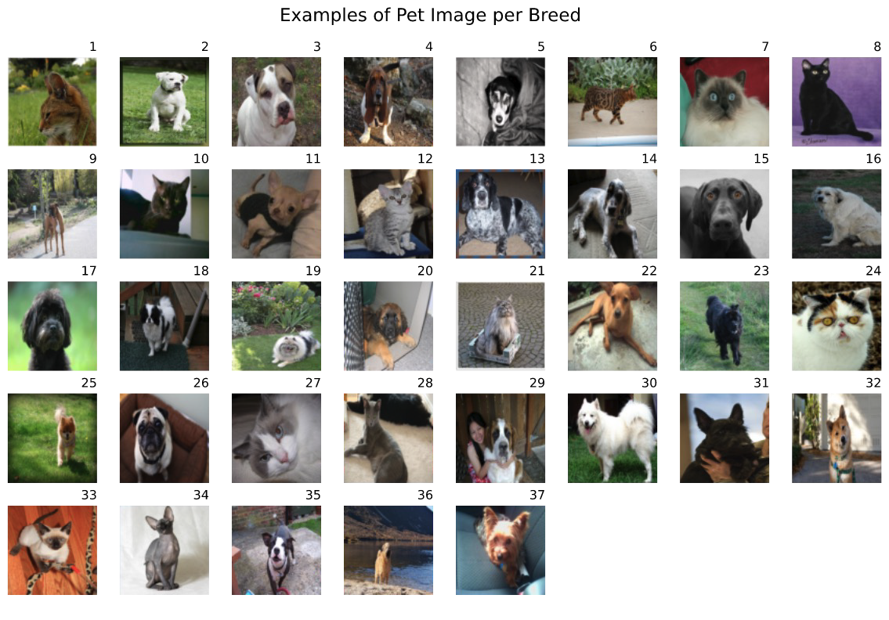
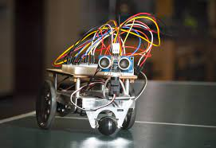
Types of Reasoning
Deductive Reasoning: Apply general theories (knowledge) to observations (observed facts) to infer new facts. “All men are mortal. Socrates is a man. Therefore, Socrates is Mortal”
Inductive Reasoning: Build general theories (knowledge) from observations (facts). “Cats and Dogs Breeds Classification Dataset”
Abductive Reasoning: Use general theories (knowledge) and incomplete observations to get the most plausible conclusion. “Learning to navigate a maze using Reinforcement Learning”

Slide 6
Types of Reasoning
Deductive Reasoning: Apply general theories (knowledge) to observations (observed facts) to infer new facts. “All men are mortal. Socrates is a man. Therefore, Socrates is Mortal”
Inductive Reasoning: Build general theories (knowledge) from observations (facts). “Cats and Dogs Breeds Classification Dataset”
Abductive Reasoning: Use general theories (knowledge) and incomplete observations to get the most plausible conclusion. “Learning to navigate a maze using Reinforcement Learning”
Initial focus on agents that gather a finite set of observations by sensing their environment.
Use of deductive reasoning to bridge the gap between what is observed (explicity) and what is known (implicitly).

Slide 7
Knowledge Representation
The field of study concerned with using formal symbols to represent a collection of propositions that is known by some agent [Brachman & Levesque, 2004].
John knows that Mary will come to the party.

Slide 8
Knowledge Representation
The field of study concerned with using formal symbols to represent a collection of propositions that is known by some agent [Brachman & Levesque, 2004].
John knows that Mary will come to the party.
The individual who holds the knowledge
The Agent

Slide 9
Knowledge Representation
The field of study concerned with using formal symbols to represent a collection of propositions that is known by some agent [Brachman & Levesque, 2004].
John knows that Mary will come to the party.
The individual who holds the knowledge
The propositional context in which the knowledge is held (knows, hopes, fears, wants, …)
The Agent
Propositional Attitude

Slide 10
Knowledge Representation
The field of study concerned with using formal symbols to represent a collection of propositions that is known by some agent [Brachman & Levesque, 2004].
John knows that Mary will come to the party.
The individual who holds the knowledge
The propositional context in which the knowledge is held (knows, hopes, fears, wants, …)
The proposition is an idea expressed by a simple declarative sentence that can be true or false.
The Agent
Propositional Attitude
Proposition p

Slide 11
Knowledge Representation
The field of study concerned with using formal symbols to represent a collection of propositions that is known by some agent [Brachman & Levesque, 2004].
John knows that Mary will come to the party.
John believes that Mary will come to the party.
Different propositional attitudes can reflect different levels of certainty in the proposition.
Knows = definitively true
Believes = subjectively true
Hopes = optimistically true…

Slide 12
Knowledge Representation Techniques

Slide 13
Knowledge Representation Techniques
}
Semantic Networks
Frames
Knowledge Graphs
Expert Systems
Graph-based Approaches
Rule-based Approaches

Slide 14
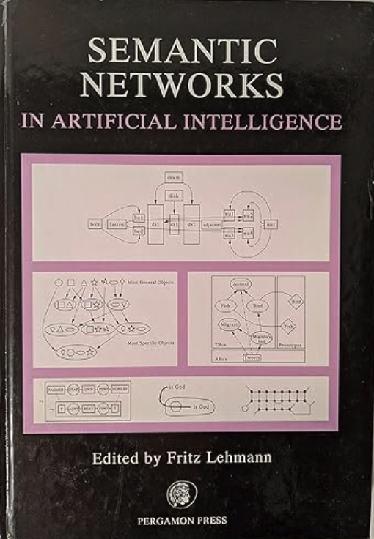
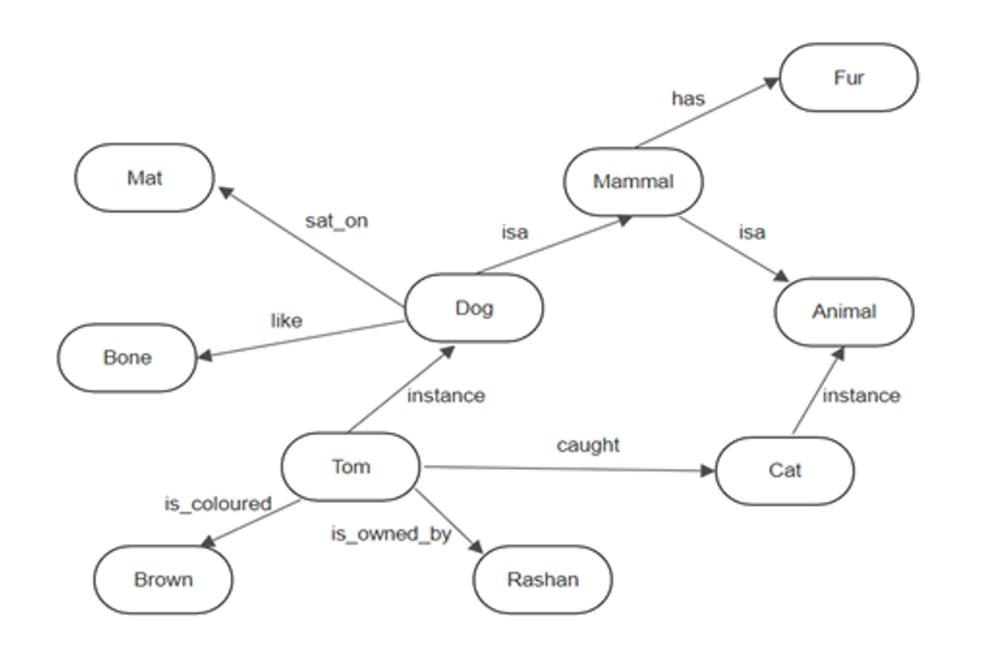
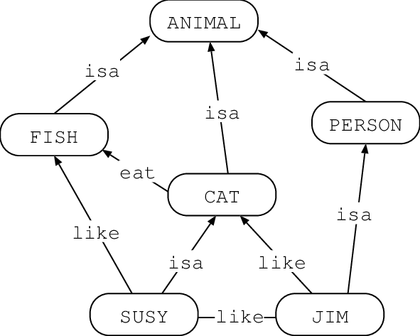
Semantic Networks
Graph-based representation of knowledge
Using graphs to model relationships between concepts (think brain-maps)
Been used for “human” reasoning since 3rd Century AD

Slide 15
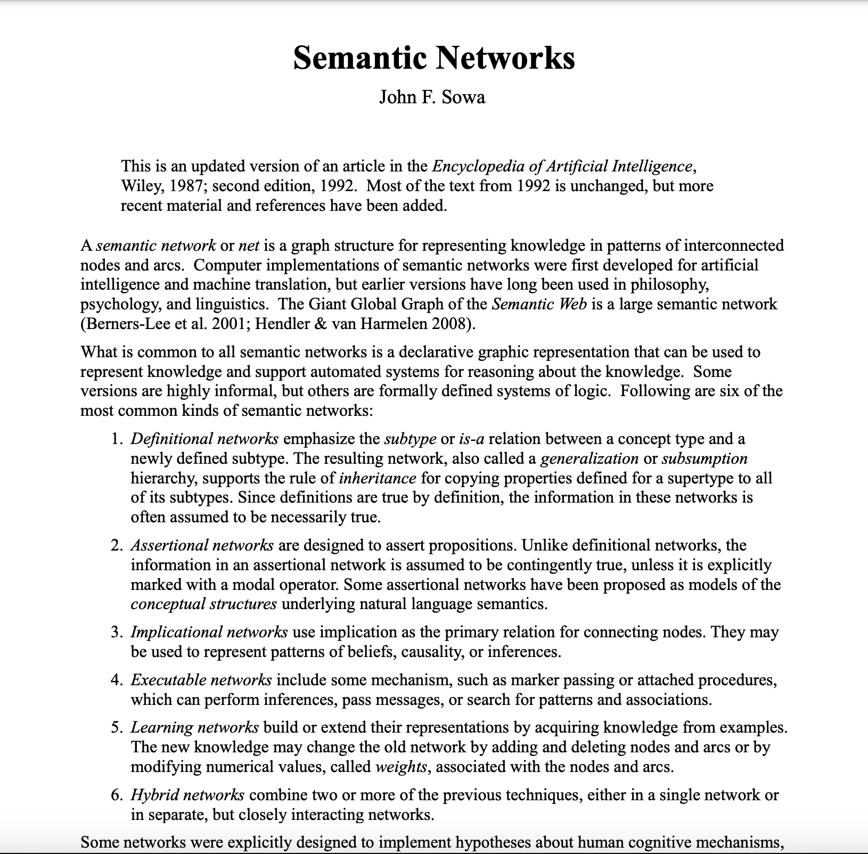
Semantic Networks
Graph-based representation of knowledge
Using graphs to model relationships between concepts (think brain-maps)
Been used for “human” reasoning since 3rd Century AD
https://www.jfsowa.com/pubs/semnet.pdf

Slide 16
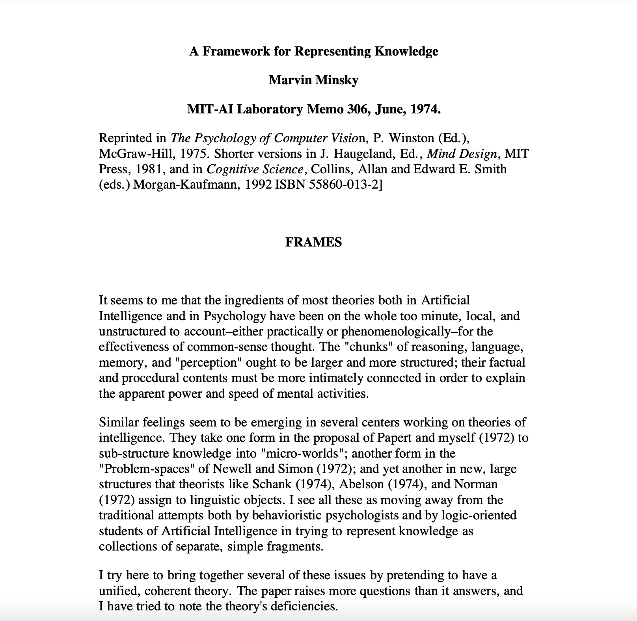
Frame-Based Systems
A frame is a data-structure for representing a stereotyped situation.
E.g. being in a certain kind of living room, or going to a child's birthday party…
Frames consist of slots which hold information:
Facts or Data
Values (called facets)
Procedures (also called procedural attachments)
IF-NEEDED: deferred evaluation
IF-ADDED: updates linked information
Default Values
For Data
For Procedures
Other Frames or Subframes
https://courses.media.mit.edu/2004spring/mas966/Minsky%201974%20Framework%20for%20knowledge.pdf

Slide 17
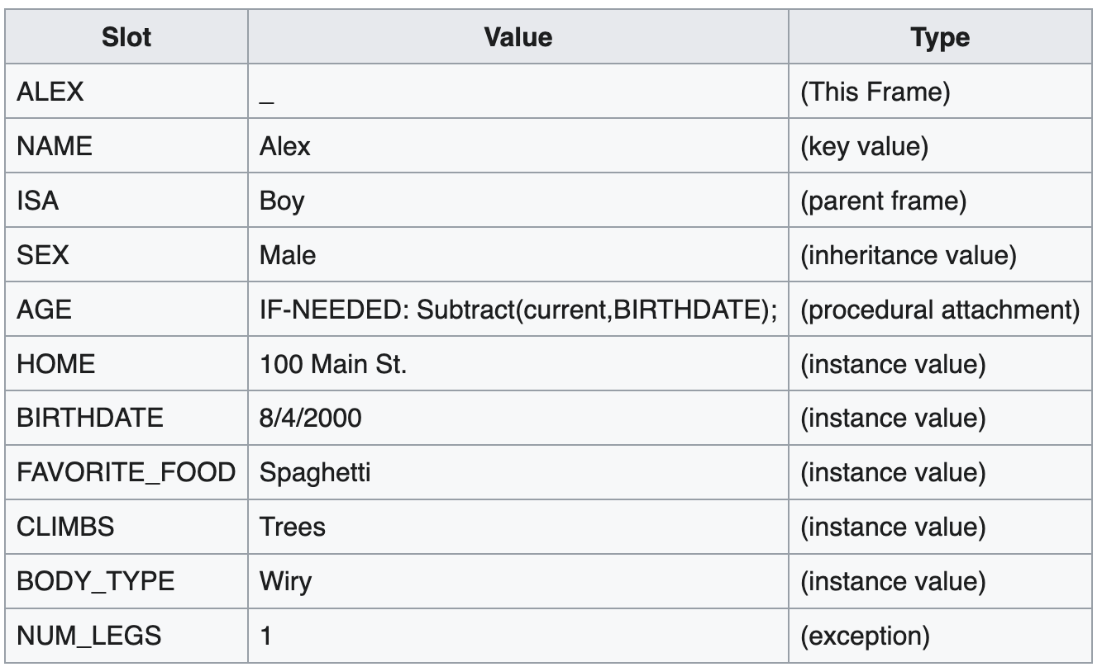
Frame-Based Systems
A frame is a data-structure for representing a stereotyped situation.
E.g. being in a certain kind of living room, or going to a child's birthday party…
Frames consist of slots which hold information:
Facts or Data
Values (called facets)
Procedures (also called procedural attachments)
IF-NEEDED: deferred evaluation
IF-ADDED: updates linked information
Default Values
For Data
For Procedures
Other Frames or Subframes
https://courses.media.mit.edu/2004spring/mas966/Minsky%201974%20Framework%20for%20knowledge.pdf

Slide 18

Knowledge Graphs
“A knowledge graph is a graph of data intended to accumulate and convey knowledge of the real world, whose nodes represent entities of interest and whose edges represent relations between these entities” [Hogan et al., 2021].
http://kgbook.org/

Slide 19
Knowledge Graphs
“A knowledge graph is a graph of data intended to accumulate and convey knowledge of the real world, whose nodes represent entities of interest and whose edges represent relations between these entities” [Hogan et al., 2021].
Syntax
graph of data
Nodes
edges
Semantics
knowledge of the real world
entities of interest
relations between entities
http://kgbook.org/

Slide 20
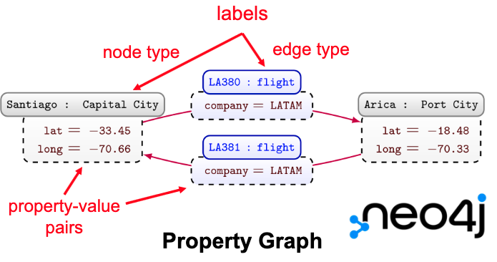
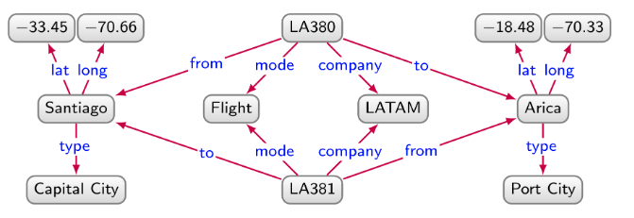
Data Models for Knowledge Graphs
Directed Edge Labelled Multigraph
Property Graph
this is defined by your eyes

Slide 21
Data Models for Knowledge Graphs
Directed Edge Labelled Multigraph
Property Graph
more minimal model
more flexible model
Property graphs can be converted to/from directed edge-labelled multigraphs [Angles et al., 2019].

Slide 22
Resource Description Framework (RDF) Graphs
RDF Graph (Turtle Syntax)
prefix : <http://example.org/>
prefix rdf: <http://www.w3.org/1999/02/22-rdf-syntax-ns#>
:LA380 :company :LATAM ;
:mode :Flight ;
:from :Santiago ;
:to :Arica .
:LA381 :company :LATAM ;
:mode :Flight ;
:from :Arica ;
:to :Santiago .
:Santiago rdf:type :CapitalCity ;
:lat -33.45 ;
:long -70.66 .
:Arica rdf:type :PortCity ;
:lat -18.48 ;
:long -70.33 .
Resource Description Framework (RDF) is a standardized data model based on directed edge-labelled multigraphs.

Slide 23
Resource Description Framework (RDF) Graphs
RDF Graph (Turtle Syntax)
prefix : <http://example.org/>
prefix rdf: <http://www.w3.org/1999/02/22-rdf-syntax-ns#>
:LA380 :company :LATAM ;
:mode :Flight ;
:from :Santiago ;
:to :Arica .
:LA381 :company :LATAM ;
:mode :Flight ;
:from :Arica ;
:to :Santiago .
:Santiago rdf:type :CapitalCity ;
:lat -33.45 ;
:long -70.66 .
:Arica rdf:type :PortCity ;
:lat -18.48 ;
:long -70.33 .
Resource Description Framework (RDF) is a standardized data model based on directed edge-labelled multigraphs.
An RDF Graph is a set of triples:
- subjects are URIs or blank nodes
- predicates are URIs
- objects are URIs, blank nodes, or literals (typed values)

Slide 24
Resource Description Framework (RDF) Graphs
RDF Graph (Turtle Syntax)
subject
prefix : <http://example.org/>
prefix rdf: <http://www.w3.org/1999/02/22-rdf-syntax-ns#>
:LA380 :company :LATAM ;
:mode :Flight ;
:from :Santiago ;
:to :Arica .
:LA381 :company :LATAM ;
:mode :Flight ;
:from :Arica ;
:to :Santiago .
:Santiago rdf:type :CapitalCity ;
:lat -33.45 ;
:long -70.66 .
:Arica rdf:type :PortCity ;
:lat -18.48 ;
:long -70.33 .
Resource Description Framework (RDF) is a standardized data model based on directed edge-labelled multigraphs.
An RDF Graph is a set of triples:
- subjects are URIs or blank nodes
- predicates are URIs
- objects are URIs, blank nodes, or literals (typed values)

Slide 25
Resource Description Framework (RDF) Graphs
predicate
RDF Graph (Turtle Syntax)
subject
prefix : <http://example.org/>
prefix rdf: <http://www.w3.org/1999/02/22-rdf-syntax-ns#>
:LA380 :company :LATAM ;
:mode :Flight ;
:from :Santiago ;
:to :Arica .
:LA381 :company :LATAM ;
:mode :Flight ;
:from :Arica ;
:to :Santiago .
:Santiago rdf:type :CapitalCity ;
:lat -33.45 ;
:long -70.66 .
:Arica rdf:type :PortCity ;
:lat -18.48 ;
:long -70.33 .
Resource Description Framework (RDF) is a standardized data model based on directed edge-labelled multigraphs.
An RDF Graph is a set of triples:
- subjects are URIs or blank nodes
- predicates are URIs
- objects are URIs, blank nodes, or literals (typed values)

Slide 26
Resource Description Framework (RDF) Graphs
predicate
RDF Graph (Turtle Syntax)
subject
prefix : <http://example.org/>
prefix rdf: <http://www.w3.org/1999/02/22-rdf-syntax-ns#>
:LA380 :company :LATAM ;
:mode :Flight ;
:from :Santiago ;
:to :Arica .
:LA381 :company :LATAM ;
:mode :Flight ;
:from :Arica ;
:to :Santiago .
:Santiago rdf:type :CapitalCity ;
:lat -33.45 ;
:long -70.66 .
:Arica rdf:type :PortCity ;
:lat -18.48 ;
:long -70.33 .
object
Resource Description Framework (RDF) is a standardized data model based on directed edge-labelled multigraphs.
An RDF Graph is a set of triples:
- subjects are URIs or blank nodes
- predicates are URIs
- objects are URIs, blank nodes, or literals (typed values)
NOTE: In first-order logic, a triple is just a
binary predicate: predicate(subject, object)
each node is a web resource wich when queried (http get request) return a rdf style document
everything here is url apart the numbers

Slide 27
Expert Systems
Expert Systems focus on procedural knowledge
Rules describe how new knowledge can be inferred from existing knowledge.
Certainty Factors can be used where there is uncertainty (e.g. medical diagnosis)
Knowledge is encoded declaratively as propositions (facts) that can be true or false.
Execution Loop
Database
Rule base
Expert systems start with some initial state relating to a problem domain which they combine with general rules about how additional state information can be derived from the current state.
Inference
Engine

Slide 28
Examples of Early Successes

Slide 29
Expert Systems: Shrdlu 1968-70 (CMU/RAND Corp)
A program that understands a subset of English and can manipulate some wooden blocks.
Implemented using Micro Planner (Carl Hewitt, 1969) & Lisp (McCarthy, 1958)
Micro Planner (precursor to Prolog) provided a logical reasoning engine based on Resolution (Robinson, 1965)
Lisp provided support for procedural code.
Led by Terry Winograd (Co-author of PageRank with Page & Brin)
Users interact with Shrdlu via a command line.
Shrdlu parses the user input and responds appropriately.
This can involve manipulating the blocks or responding to some user query…

Slide 30
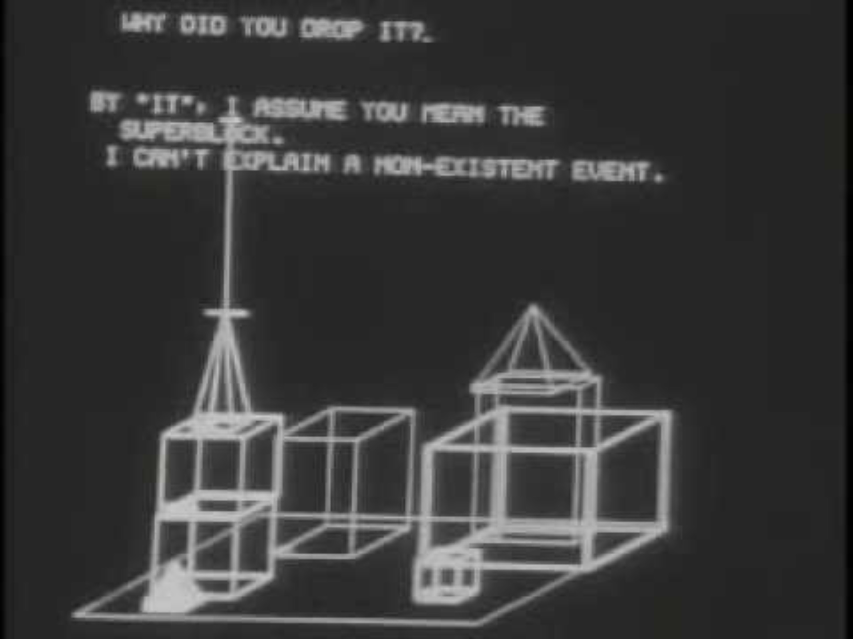
Expert Systems: Shrdlu 1968-70 (CMU/RAND Corp)
Person: Pick up a big red block.
Computer: OK.
Person: Grasp the pyramid.
Computer: I don't understand which pyramid you mean.
Person (changing their mind): Find a block which is taller than the one you are holding and put it into the box.
Computer: By "it", I assume you mean the block which is taller than the one I am holding.
Computer: OK.
Person: What does the box contain?
Computer: The blue pyramid and the blue block.
Person: What is the pyramid supported by?
Computer: The box.
Person: How many blocks are not in the box?
Computer: Four of them.
Person: Is at least one of them narrower than the one which I told you to pick up?
Computer: Yes, the red cube.
https://www.youtube.com/watch?v=bo4RvYJYOzI

Slide 31
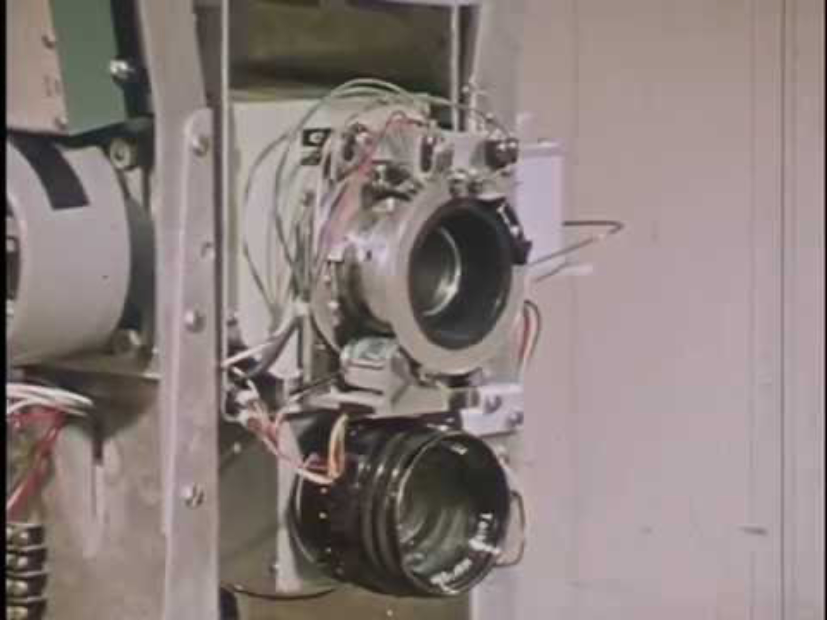
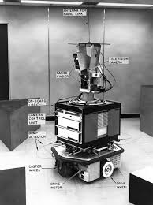
Shakey: 1966-72 (SRI – Stanford Research Institute)
First fully embodied AI Robot
Funded by ARPA
Team led by Charles Rosen
Project focused on “mobile automaton”
Named after the way it moves
Key Contributions:
1st Layered architecture (the basis of modern robotics)
1st Line/Edge Detection Algorithm
STRIPS: STanford Research Institute Problem Solver (Planner)
A* Search Algorithm (Heuristic Dijkstra Shortest Path)
Receiver of the Prestigious IEEE Milestone Award, 2017
https://www.youtube.com/watch?v=GmU7SimFkpU

Slide 32
Physical Symbol System Hypothesis

Slide 33
Knowledge Representation Techniques
“A physical symbol system has the necessary and sufficient means for general intelligent action”
(Newell & Simon, 1978)

Slide 34
The Case for PSSH
Psychological Experiments showed that humans tended to solve complex problems (e. g. planning, puzzle solving) by exploring the problem space in a step-by-step manner.
Many used symbolic representations to aid in their problem-solving activities
This type of research led to the emergence of cognitive science as a discipline.
Many early successes in AI/Computer Science were in symbolic spaces:
Proving logical theorem (Logic Theorist)
Playing Games (Checkers, Chess, …)
Programs/Programming

Slide 35
Some Clarifications
Psychological Experiments showed that humans tended to solve complex problems (e. g. planning, puzzle solving) by exploring the problem space in a step-by-step manner.
Many used symbolic representations to aid in their problem-solving activities
This type of research led to the emergence of cognitive science as a discipline.
Many early successes in AI/Computer Science were in symbolic spaces:
Proving logical theorem (Logic Theorist)
Playing Games (Checkers, Chess, …)
Programs/Programming
PSSH is targeted a systems that:
Use Semantic Symbols not Dynamic Symbols
Aim to deliver General Intelligence not Narrow (task specific) Intelligence
Support Intelligent action not consciousness

Slide 36
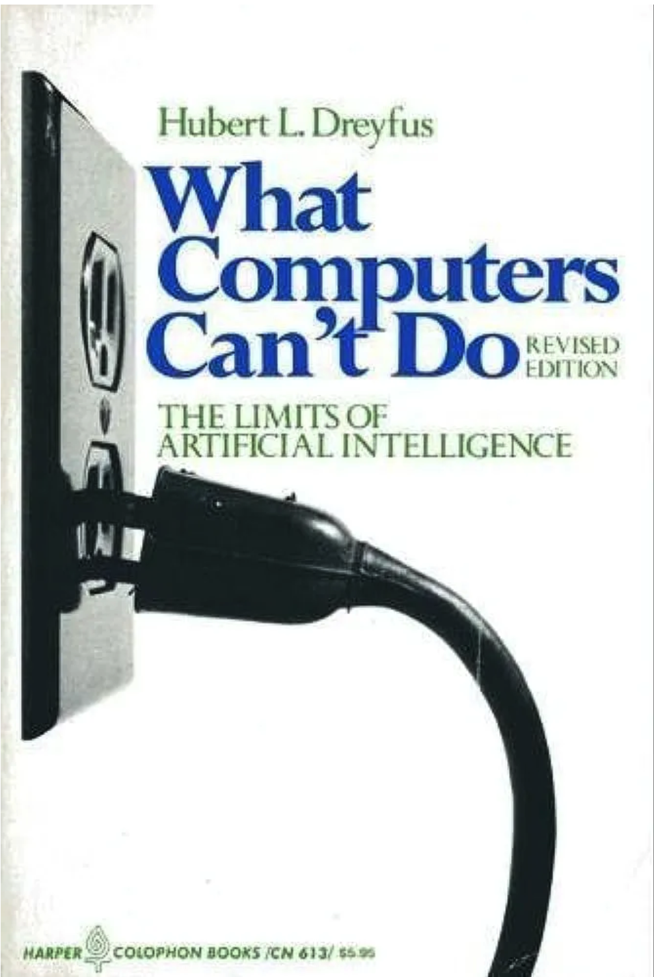
Criticisms of PSSH
Dreyfus argues that PSSH is invalid because real experts solve problems intuitively rather that systematically through trial an error…
Searle uses the Chinese Room thought experiment to argue that machines can manipulate symbols without understanding them…
Brooks argues that ”Elephants Don’t Play Chess”, pointing out that abstractions are not always necessary – sometimes the world is its own best model...
The rise of Connectionism has pushed research away from symbol systems towards sub-symbolic approaches.
https://www.docdroid.net/wmxbi7O/dreyfus-what-computers-cant-do-pdf

